Slide 1
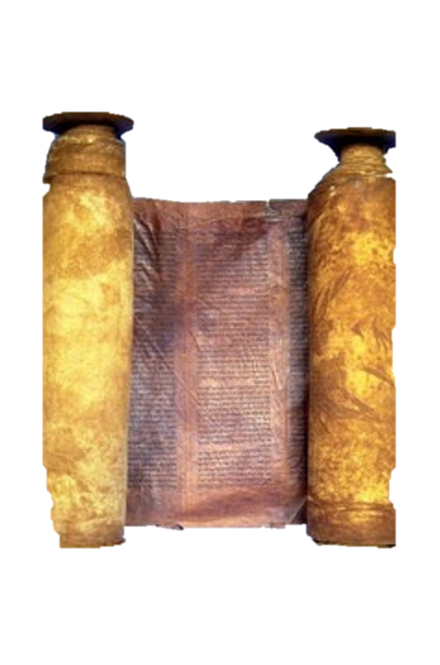
A free CD of this message will be available immediately following the service
2 Kings
3-4
A podcast will also be available later this week at calvaryokc.com

Slide 2
Israel
Judah
Ahaziah, 853-852
Jehoshapat, 871-847
Jehoram, 852-841
2 kings 3-4

Slide 3
2 kings 3-4

Slide 4
Azariah ~ 853-852 BC
Ahab ~ 874-853 BC
Jehoram~ 852-841 BC
870 BC
865 BC
855 BC
850BC
845 BC
840BC
2 Chron. 19:1-3
2 Chron. 20:35-37
2 kings 3-4

Slide 5
2 kings 3-4

Slide 6
Israel
Judah
Moab
Edom
2 kings 3-4

Slide 7
2 kings 3-4

Slide 8
Roundabout route ~ KJV, fetched a compass
2 kings 3-4

Slide 9
2 kings 3-4

Slide 10
Terry Clark ~ “Music is the language of the worshipper.”
2 kings 3-4

Slide 11
2 kings 3-4

Slide 12
Edom ~ eh-DOM (H123)
Red ~ ah-DOM (H122)
Blood ~ DOM (H1818)
2 kings 3-4

Slide 13
2 kings 3-4

Slide 14
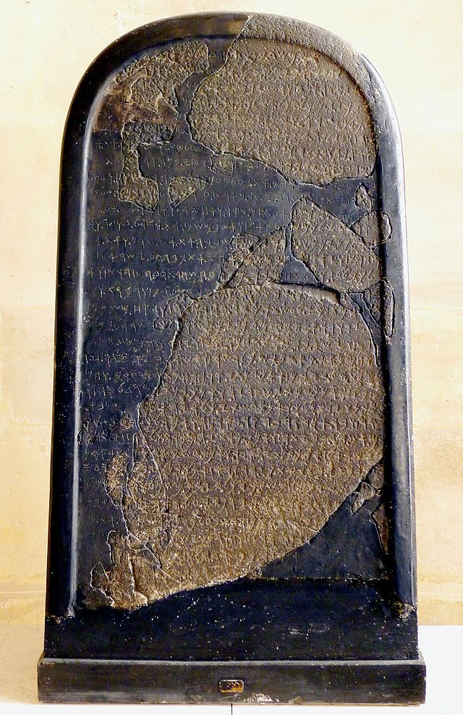
The Moabite Stone
2 kings 3-4

Slide 15
2 kings 3-4

Slide 16
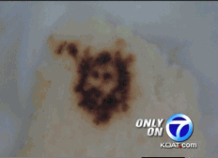
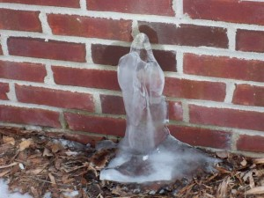
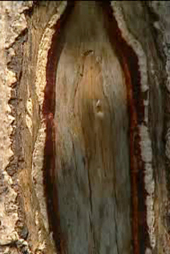
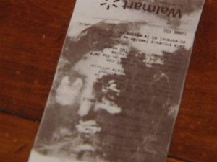
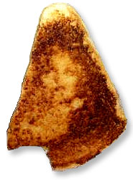
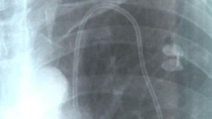
Holy tortilla
Virgin Mary dripping faucet
Blessed Virgin tree trunk
Holy Wal-Mart receipt
Grilled Cheese Mary
Holy X-ray
2 kings 3-4

Slide 17
2 kings 3-4

Slide 18
Servant ~ na’ar - same word as in 2:23-24 (youths)
2 kings 3-4

Slide 19
2 kings 3-4

Slide 20
It is well ~ shalom
2 kings 3-4

Slide 21
2 kings 3-4

Slide 22
Alexander MacLaren ~ “How much better would it have been for the Church if its teachers had been more willing to copy his modesty, and said about a great many things, ‘The Lord hath hid it from me’!”
2 kings 3-4

Slide 23
2 kings 3-4

